Slide 1

22AIE112 : DATA STRUCTURES & ALGORITHMS 1 &
22AIE111 : OBJECT ORIENTED PROGRAMMING IN JAVA
Fitness Member Management System
Team 8 AIE - C
G Prajwal Priyadarshan – CB.SC.U4AIE24214
Kabilan K – CB.SC.U4AIE24224
Kishore B - CB.SC.U4AIE24227
Rahul LS - CB.SC.U4AIE24248

Slide 2
Abstract
The Fitness Member Management System streamlines operations using data structures and OOP principles for efficient management. It handles member registration, workout schedules, membership plans, and attendance tracking using stacks, queues, linked lists, hash tables, graphs, trees, and arrays. Stacks track workout histories, queues manage check-ins, and hash tables enable quick data access. Graphs and trees optimize workout allocations, while OOP principles like inheritance, polymorphism, modularity and encapsulation ensure scalability. Real-time attendance monitoring is automated, and the system is designed for future enhancements like progress tracking and personalized recommendations. This project demonstrates a practical and innovative application of DSA and OOP in fitness management.

Slide 3
Table of Contents
Introduction
Objectives
Data Structure
Architecture
Methodology
Expected outcomes

Slide 4
Introduction
A Fitness Member Management System (FMMS) is a software solution designed to manage the daily operations of gym or fitness center .
It integrates various functions such as member registration, attendance tracking, class scheduling, trainer and member management, billing, membership renewals, and progress tracking into a single system.
FMMS enhances efficiency by automating administrative tasks, reducing paperwork, and ensuring secure access to member data.
With digital records, fitness centers can improve operational efficiency, streamline member engagement, and enhance customer satisfaction.
Modern FMMS solutions are built using advanced technologies such as databases, cloud computing, and secure APIs. They enable seamless communication between staff, trainers, and members, ensuring a well-organized and effective fitness environment.

Slide 5
Objectives
Primary Objective: Develop a robust system that streamlines fitness centre management by leveraging data structures and object-oriented programming principles.
Specific Goals:
Efficient member registration and data management.
Automated workout schedule allocation.
Membership plans and fee management.
Attendance monitoring and tracking.
Integration of OOP principles to ensure modularity and scalability.

Slide 6
DATA STRUCTURES
CLASS | ATTRIBUTE | DATA STRUCTURE | DESCRIPTION
Member_Registration | ADD_A_MEMBER | DICTIONARY | Manages the registration and maintenance of member records like adding, updating, deleting, and searching for members
 | UPDATE_MEMBER | DICTIONARY
 | DELETE_A_MEMBER | DICTIONARY
 | SEARCH_MEMBER | DICTIONARY
Workout_Schedule _Allocation | LOG | QUEUE | Handles the allocation and management of workout schedules for members.
 | VIEW_RECENT | QUEUE
Membership_Plans_ And_Fees | RENEWAL | ARRAY | Manages membership plans, subscription levels, and renewal processes.
 | SUBSCRIPTION | PRIORITY QUEUE
Attendance_Tracking | CHECK_IN_OR_OUT | QUEUE | Tracks member attendance, including check-ins and check-outs
 | ATTENDENCE_REPORT | PRIORITY QUEUE
FEEDBACK | FEEDBACK | QUEUE | Collects and organizes member feedback or suggestions

Slide 7
CLASS | ATTRIBUTE | DATA STRUCTURE | DESCRIPTION
GAMIFICATION | LEADERBOARD | DICTIONARY | Encourages member engagement through challenges and rewards.
 | REWARDS | DICTIONARY
DIET_PLAN_MANAGEMENT | DIET_PLANS | GRAPH | Manages personalized diet plans for members.
CAPACITY_MANAGEMENT | CAPACITY | QUEUE | Monitors and manages gym capacity in real-time.
EQUIPMENT_MANAGEMNT | TRACK | PRIORITY QUEUE | Tracks and prioritizes the usage of gym equipment
EMERGENCY_CONTACT | REGISTER | DOUBLE_LINKED_LIST | Maintains emergency contact information for all members.
REPORT | REPORT | GRAPH | Generates and visualizes fitness or gym performance reports.
GUEST | TRIAL | QUEUE | Manages the registration of guests for trial memberships

Slide 8
Architecture

Slide 9
MEMBER_REGISTRATION
DELETE_MEMBER
SEARCH_MEMBER
UPDATE_MEMBER
ADD_MEMBER
WORKOUT_SCHEDULE_ALLOCATION
LOG
VIEW_RECENT
MEMBERSHIPS_PLANS_AND_FEES
RENEWAL
SUBSCRIPTION
ATTENDENCE
CHECK_IN_OUT
ATTENDENCE_REPORT
Gamification
LEADERBOARD
REWARDS
Diet Plan Management –
DIET PLANS
Capacity Management
CAPACITY
ADMIN
WORKOUT_SCHEDULE_ALLOCATION
LOG
VIEW_RECENT
ATTENDENCE
CHECK_IN_OUT
Diet Plan Management
DIET PLANS
FEEDBACK
MEMBERSHIPS_PLANS_AND_FEES
RENEWAL
SUBSCRIPTION
GUEST
FEEDBACK
Equipment Mnagement
Register
try
USER

Slide 10
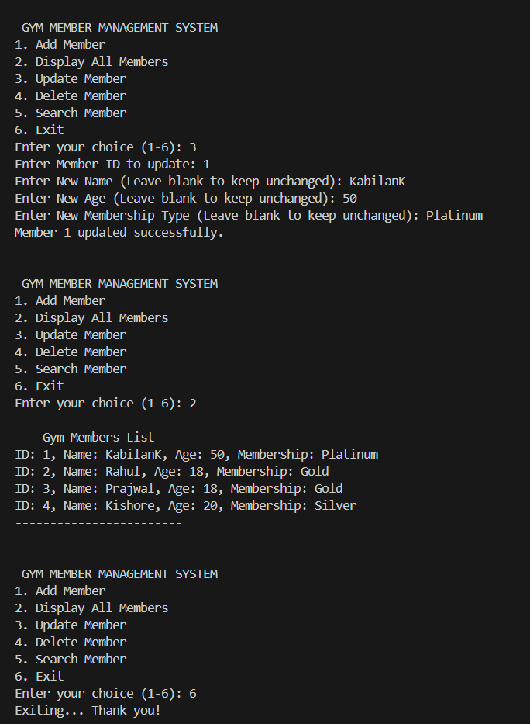
Results Obtained till now:
We started with doing member management.
OOPs Concepts Used:
1.Classes & Objects
2.Encapsulation
3.Abstraction
Data Structure Used:
1.Fast Lookup
2.Efficient Storage
3.Easy to delete/Update
Why not list?
1.Searching ,Updating, Deleting O(n)

Slide 11
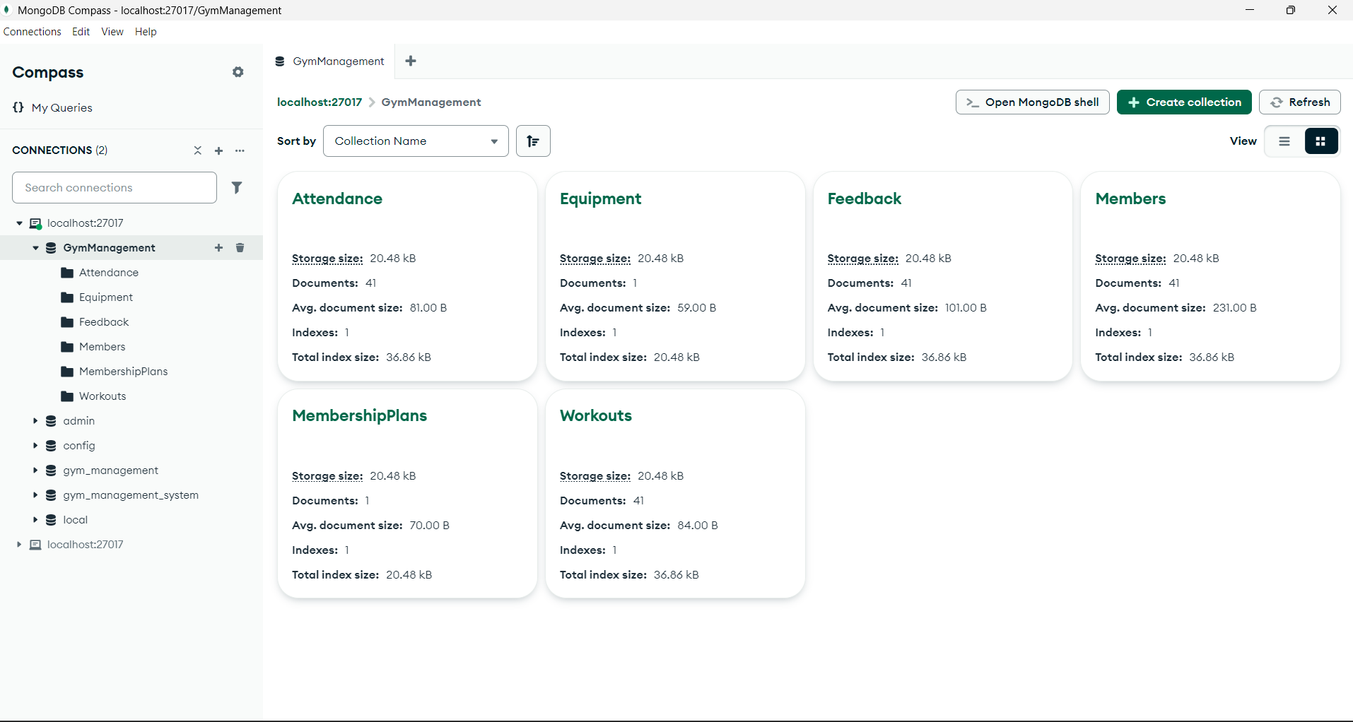

Slide 12
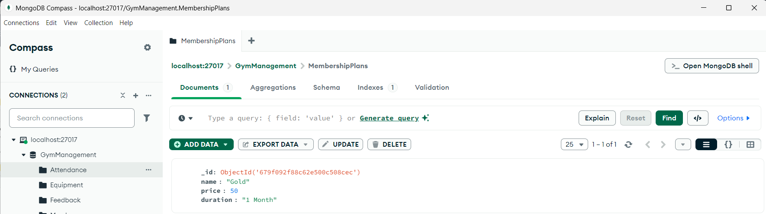
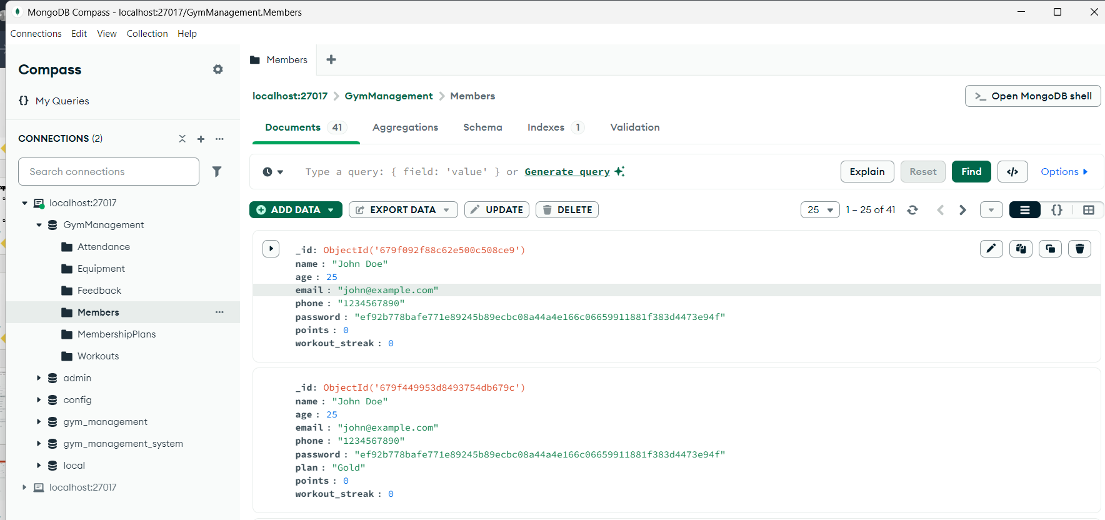
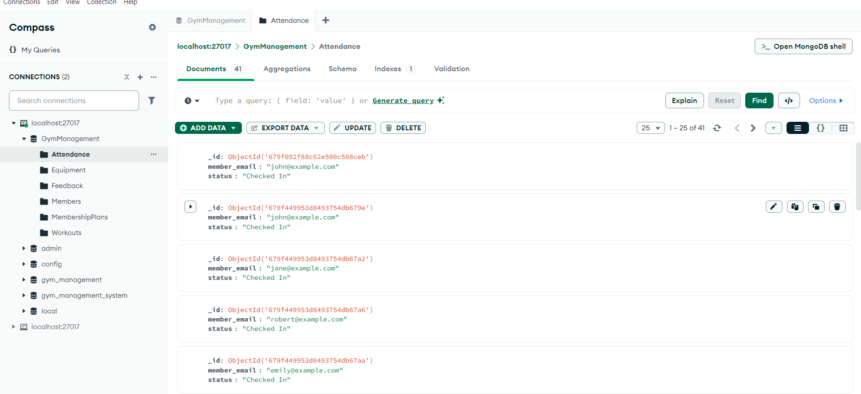

Slide 13
Expected Outcomes
By integrating Data Structures and Algorithms (DSA) with a user-interface, the Fitness Member Management System achieves an efficient and structured approach to handling memberships, attendance, and fitness tracking. The use of hash maps and trees ensures fast searching and retrieval of member data, while stacks and queues streamline operations like registration, renewals, and workout tracking.
With an interactive UI, users can seamlessly register, check attendance, and monitor fitness progress, making the system both functional and intuitive. Security features like password hashing and role-based access enhance data protection, while graph-based analytics provide insights into member activity and financial trends.

Slide 14
Reference
Word File

Slide 15
Thank you
Team – 8 , C - Batch

